Slide 1

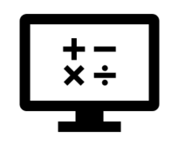
Fundamentals
Where do I find MATLAB? Here!
Do I have to have MATLAB installed on my computer right now? No, you can use MATLAB Online!

Slide 2

Table of Contents
MATLAB: More Than a Programming Language What we've covered this week in Part 8
MATLAB Live Script

Slide 3
What we've covered this week in Part 7
This week in Part 7 we learnt about:
MATLAB Grader

Slide 4
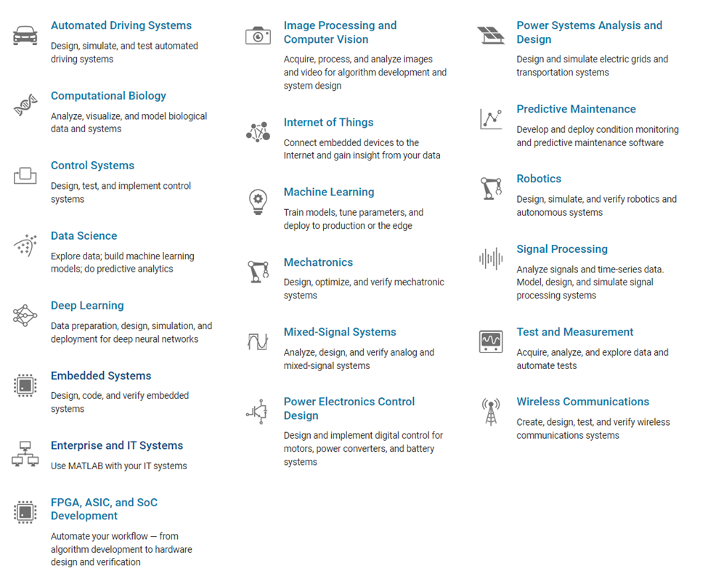
MATLAB: More Than a Programming Language
MATLAB provides a vast library of toolboxes, that spans everything from Signal and Image Processing, Control Systems, Wireless Communications and Computational Finance, to Robotics, Deep Learning & AI and more!

Slide 5
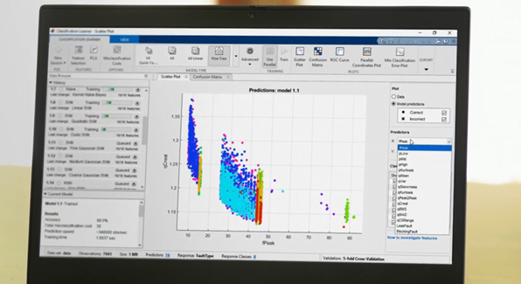
MATLAB: More Than a Programming Language
MATLAB also includes pre-built apps and allows you to easily build your own, using App Designer, for when point and click is the best way to analyse and design.

Slide 6
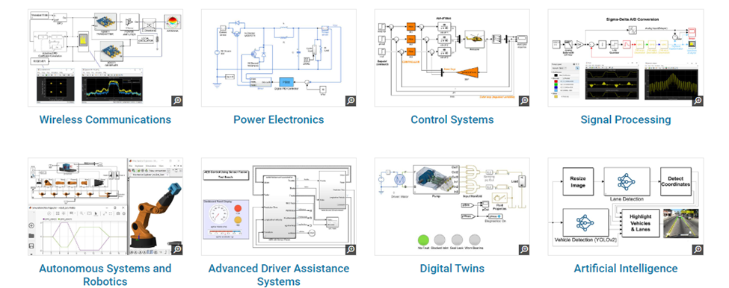
Simulink for Every Project
Simulink is a block diagram environment used to design systems with multidomain models, simulate before moving to hardware, and deploy without writing code. For more on Simulink click here!
The best and brightest engineers and scientists in the world use MATLAB and Simulink as tools of inspiration and innovation. The result: solutions that are transforming the way we live, work, and learn.

Slide 7

Simulink for Every Project
Read about some of these solutions:
Pilotless Helicopters Deliver Large Payloads with Precision
Hydrogen Fuel Cells Reduce CO2 Emissions

Slide 8
What we've covered this week in Part 8
This week in Part 8 we learnt about:
MATLAB: more than a programming language

Slide 9
MATLAB Live Script
Click on the link below for this lecture’s MATLAB live Script
Week_1_Part_8_Fundamentals.mlx
Copyright 2022 The MathWorks, Inc. & Opti-Num Solutions (Pty) Ltd.

